Slide 1
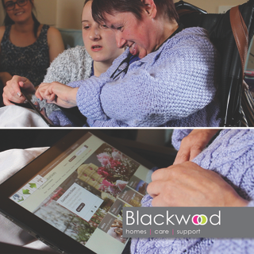

CleverCogs User Data Comic Visualisation
Ailbhe McKinney
Heather Love
Li Kungang
Peng Zijun
Wu Mengyi

Slide 2





CleverCogs?
CleverCogs is a customisable entertainment/services system, accessed through a tablet, offered by Blackwood Homes to every customer receiving care services.
Blackwood would like to understand how different users access entertainment through the system.

Slide 3
Our Data
Every link clicked by a user through CleverCogs over the past 2 years - over 640,000 recorded links
User demographic data including age, gender, registered condition/disability and location
Duplicate entries were removed
Null/empty demographic fields were only removed if necessary for the analysis to avoid over-cleaning

Slide 4
How did we cluster the data to make it more meaningful?
There were 26 different health conditions.
We decided to group the conditions to make visualisation more meaningful: Mental Health Conditions, Physical disabilities, Intellectual disabilities, physical/intellectual disabilities, and Elder care requirements
Age of the users ranged from 18 to 120. We clustered the ages into age bands (18-35, 36-50, 51-75 & 75+)

Slide 5
Why we choose data comics to visualize our data?
1. Preferred to infographics
2. Improves memory and understanding
3. Accessible to a wide audience
Wang, Z., Wang, S., Farinella, M., Murray-Rust, D., Henry Riche, N., & Bach, B. (2019, May). Comparing effectiveness and engagement of data comics and infographics. In Proceedings of the 2019 CHI Conference on Human Factors in Computing Systems (pp. 1-12).

